Slide 1

DESIGN AND ANALYSIS OF ALGORITHMS (113939)
Dr. Owais Hussain

Slide 2

Agenda
Quicksort
Quicksort Simulation
Quicksort - 1st pass
Quicksort – 2nd pass
Quicksort – 3rd pass
Exercise

Slide 3
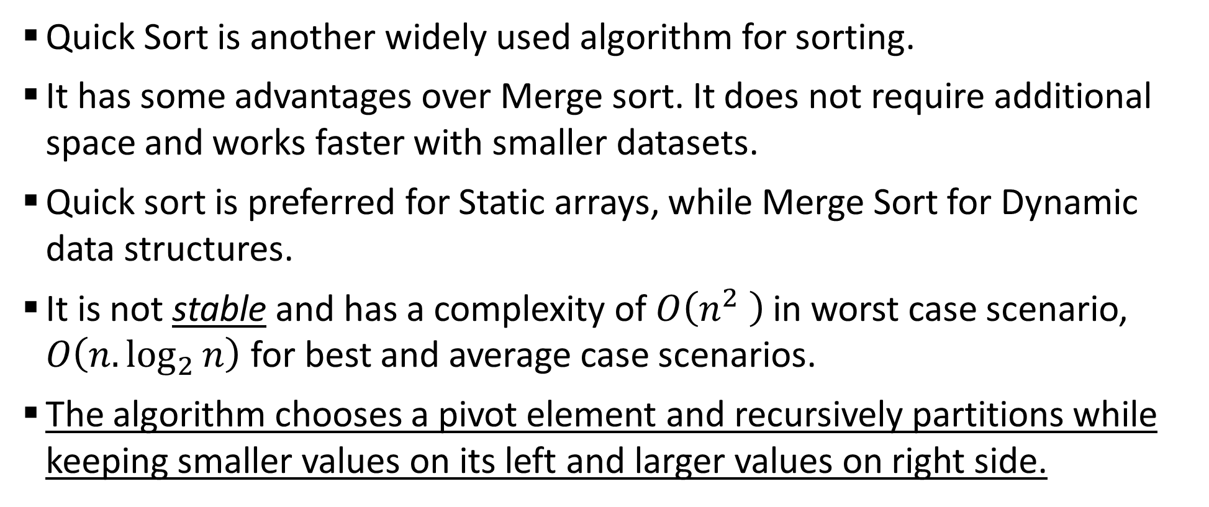
Sample 2
Quick Sort
Quick Sort is another widely used algorithm for sorting.
It has some advantages over Merge sort. It does not require additional space and works faster with smaller datasets.
Quick sort is preferred for Static arrays, while Merge Sort for Dynamic data structures.
It is not stable and has a complexity of $O\left(n^{2} \right)$ in worst case scenario, $O\left(n.\log_{2}{n}\right)$ for best and average case scenarios.
The algorithm chooses a pivot element and recursively partitions while keeping smaller values on its left and larger values on right side.

Slide 4
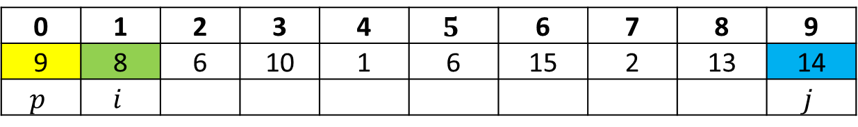
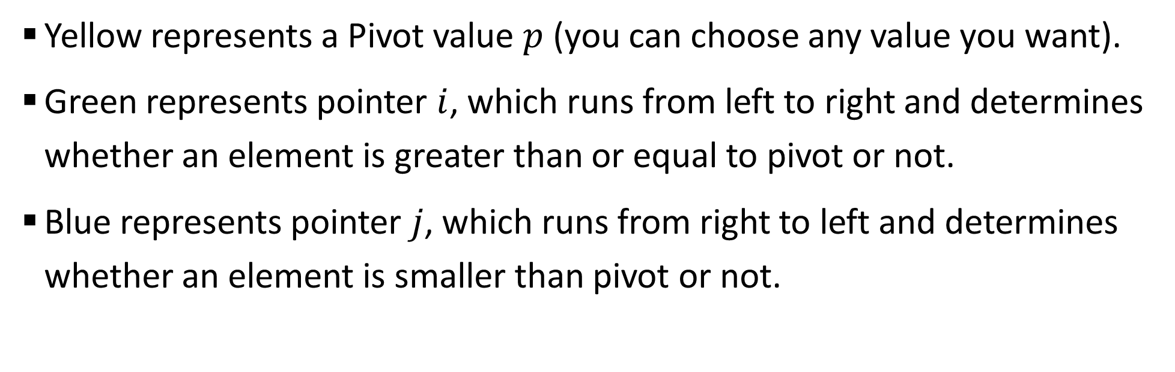
Sample 2
Quick Sort Simulation
0 | 1 | 2 | 3 | 4 | $$5$$ | 6 | 7 | 8 | 9
9 | 8 | 6 | 10 | 1 | 6 | 15 | 2 | 13 | 14
$$p$$ | $$i$$ |  |  |  |  |  |  |  | $$j$$
Yellow represents a Pivot value $p$ (you can choose any value you want).
Green represents pointer $i$, which runs from left to right and determines whether an element is greater than or equal to pivot or not.
Blue represents pointer $j$, which runs from right to left and determines whether an element is smaller than pivot or not.

Slide 5

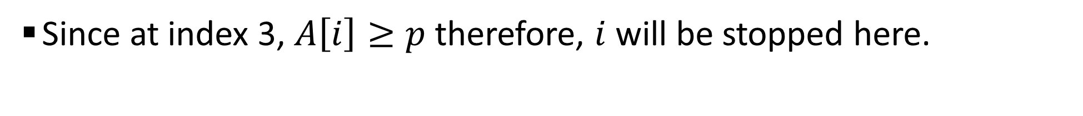
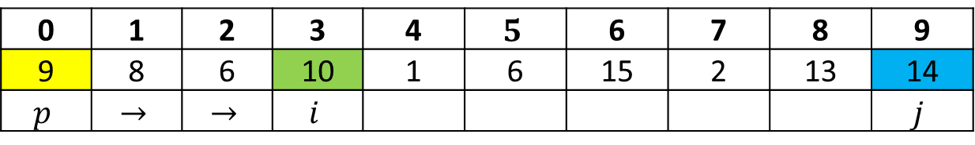
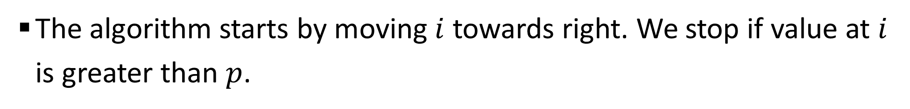
Sample 2
Quick Sort – 1st pass
The algorithm starts by moving $i$ towards right. We stop if value at $i$ is greater than $p$.
0 | 1 | 2 | 3 | 4 | $$5$$ | 6 | 7 | 8 | 9
9 | 8 | 6 | 10 | 1 | 6 | 15 | 2 | 13 | 14
$$p$$ | $$i$$ |  |  |  |  |  |  |  | $$j$$
Since at index 3, $A\left[i\right]≥p$ therefore, $i$ will be stopped here.
0 | 1 | 2 | 3 | 4 | $$5$$ | 6 | 7 | 8 | 9
9 | 8 | 6 | 10 | 1 | 6 | 15 | 2 | 13 | 14
$$p$$ | $$→$$ | $$→$$ | $$i$$ |  |  |  |  |  | $$j$$

Slide 6
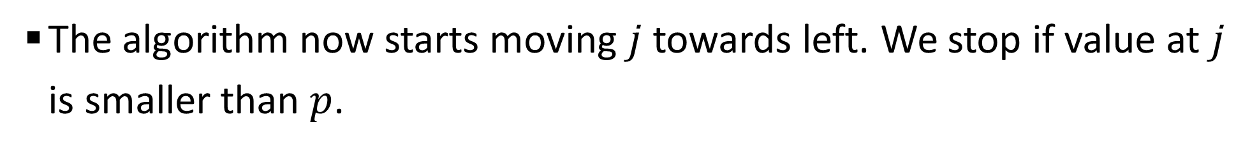
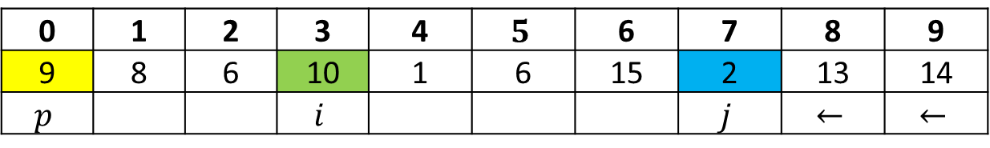

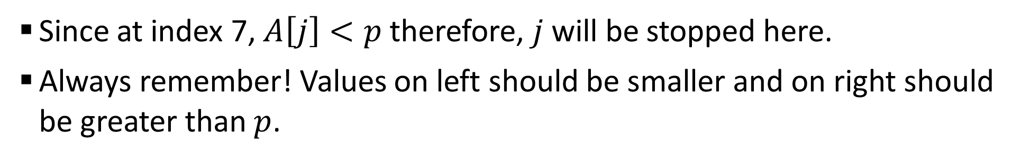
Sample 2
Quick Sort – 1st pass
The algorithm now starts moving $j$ towards left. We stop if value at $j$ is smaller than $p$.
0 | 1 | 2 | 3 | 4 | $$5$$ | 6 | 7 | 8 | 9
9 | 8 | 6 | 10 | 1 | 6 | 15 | 2 | 13 | 14
$$p$$ |  |  | $$i$$ |  |  |  |  |  | $$j$$
Since at index 7, $A\left[j\right]<p$ therefore, $j$ will be stopped here.
Always remember! Values on left should be smaller and on right should be greater than $p$.
0 | 1 | 2 | 3 | 4 | $$5$$ | 6 | 7 | 8 | 9
9 | 8 | 6 | 10 | 1 | 6 | 15 | 2 | 13 | 14
$$p$$ |  |  | $$i$$ |  |  |  | $$j$$ | $$←$$ | $$←$$

Slide 7
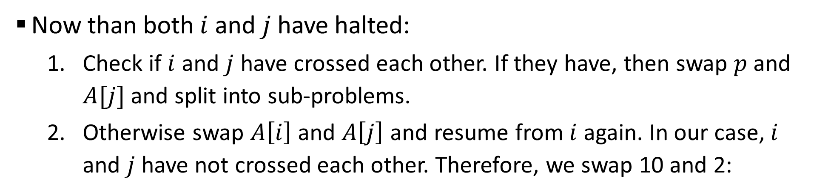


Sample 2
Quick Sort – 1st pass
Now than both $i$ and $j$ have halted:
Check if $i$ and $j$ have crossed each other. If they have, then swap $p$ and $A[j]$ and split into sub-problems.
Otherwise swap $A\left[i\right]$ and $A\left[j\right]$ and resume from $i$ again. In our case, $i$ and $j$ have not crossed each other. Therefore, we swap 10 and 2:
0 | 1 | 2 | 3 | 4 | $$5$$ | 6 | 7 | 8 | 9
9 | 8 | 6 | 10 | 1 | 6 | 15 | 2 | 13 | 14
$$p$$ |  |  | $$i$$ |  |  |  | $$j$$
0 | 1 | 2 | 3 | 4 | $$5$$ | 6 | 7 | 8 | 9
9 | 8 | 6 | 2 | 1 | 6 | 15 | 10 | 13 | 14
$$p$$ |  |  | $$i$$ |  |  |  | $$j$$ | $$←$$ | $$←$$

Slide 8
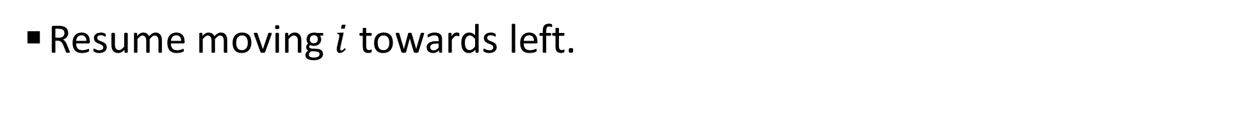
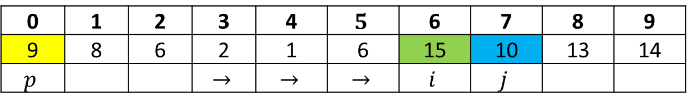

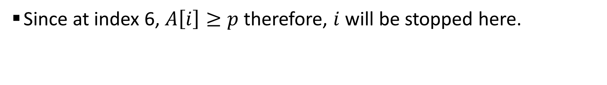
Sample 2
Quick Sort – 1st pass
Resume moving $i$ towards left.
0 | 1 | 2 | 3 | 4 | $$5$$ | 6 | 7 | 8 | 9
9 | 8 | 6 | 2 | 1 | 6 | 15 | 10 | 13 | 14
$$p$$ |  |  | $$i$$ |  |  |  | $$j$$
Since at index 6, $A\left[i\right]≥p$ therefore, $i$ will be stopped here.
0 | 1 | 2 | 3 | 4 | $$5$$ | 6 | 7 | 8 | 9
9 | 8 | 6 | 2 | 1 | 6 | 15 | 10 | 13 | 14
$$p$$ |  |  | $$→$$ | $$→$$ | $$→$$ | $$i$$ | $$j$$

Slide 9

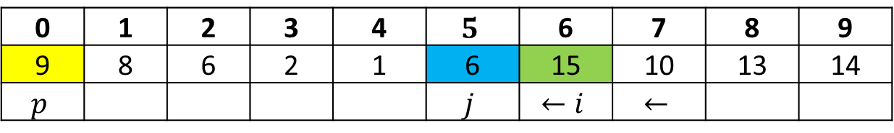
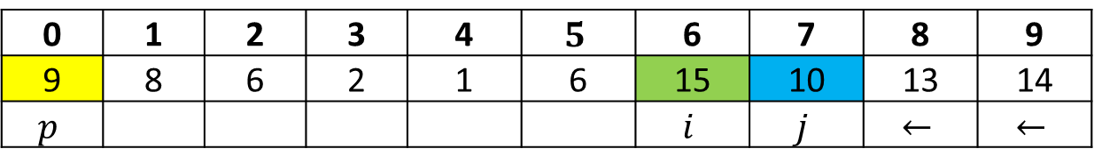
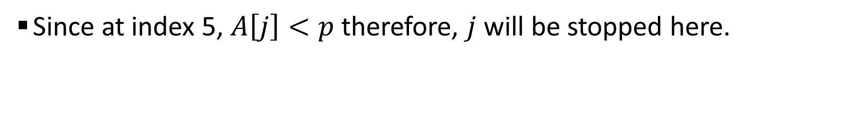
Sample 2
Quick Sort – 1st pass
Now we move $j$ until $A\left[j\right]<p.$
0 | 1 | 2 | 3 | 4 | $$5$$ | 6 | 7 | 8 | 9
9 | 8 | 6 | 2 | 1 | 6 | 15 | 10 | 13 | 14
$$p$$ |  |  |  |  |  | $$i$$ | $$j$$ | $$←$$ | $$←$$
Since at index 5, $A\left[j\right]<p$ therefore, $j$ will be stopped here.
0 | 1 | 2 | 3 | 4 | $$5$$ | 6 | 7 | 8 | 9
9 | 8 | 6 | 2 | 1 | 6 | 15 | 10 | 13 | 14
$$p$$ |  |  |  |  | $$j$$ | $$←i$$ | $$←$$

Slide 10
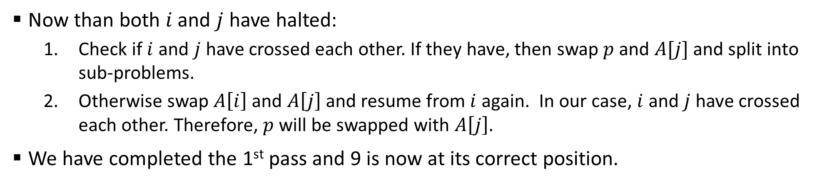

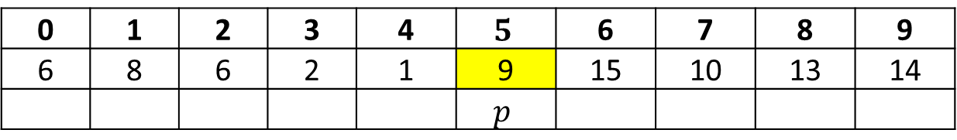
Sample 2
Quick Sort – 1st pass
Now than both $i$ and $j$ have halted:
Check if $i$ and $j$ have crossed each other. If they have, then swap $p$ and $A[j]$ and split into sub-problems.
Otherwise swap $A\left[i\right]$ and $A\left[j\right]$ and resume from $i$ again. In our case, $i$ and $j$ have crossed each other. Therefore, $p$ will be swapped with $A\left[j\right]$.
We have completed the 1st pass and 9 is now at its correct position.
0 | 1 | 2 | 3 | 4 | $$5$$ | 6 | 7 | 8 | 9
9 | 8 | 6 | 2 | 1 | 6 | 15 | 10 | 13 | 14
$$p$$ |  |  |  |  | $$j$$ | $$i$$
0 | 1 | 2 | 3 | 4 | $$5$$ | 6 | 7 | 8 | 9
6 | 8 | 6 | 2 | 1 | 9 | 15 | 10 | 13 | 14
 |  |  |  |  | $$p$$

Slide 11
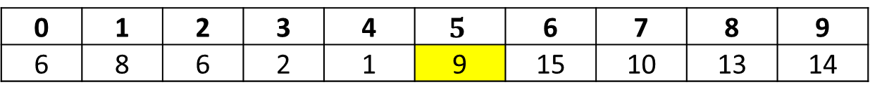
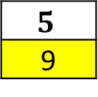
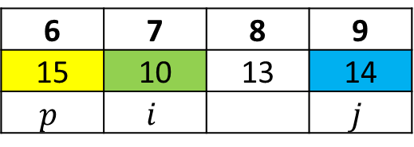
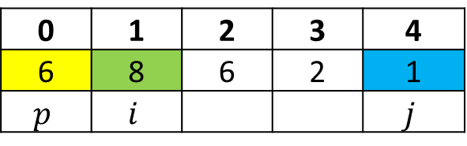
Sample 2
Quick Sort – 2nd pass
The Array is now ready to be split into two subproblems.
The pivots and pointers will be defined for both subarrays.
0 | 1 | 2 | 3 | 4 | $$5$$ | 6 | 7 | 8 | 9
6 | 8 | 6 | 2 | 1 | 9 | 15 | 10 | 13 | 14
$$5$$
9
0 | 1 | 2 | 3 | 4
6 | 8 | 6 | 2 | 1
$$p$$ | $$i$$ |  |  | $$j$$
6 | 7 | 8 | 9
15 | 10 | 13 | 14
$$p$$ | $$i$$ |  | $$j$$

Slide 12
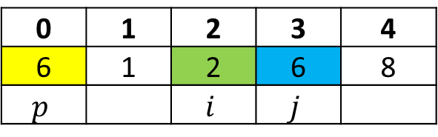
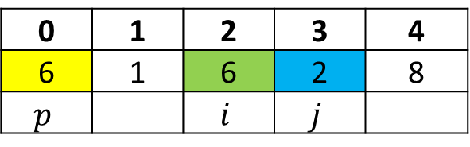
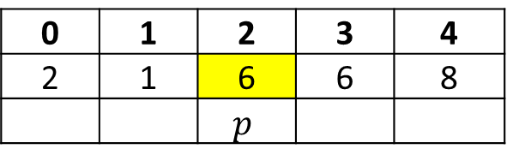
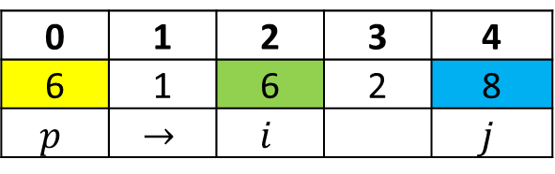
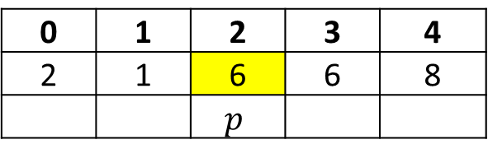
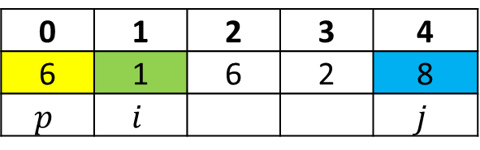
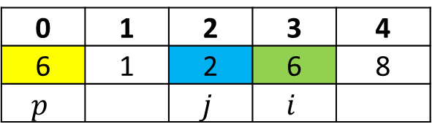

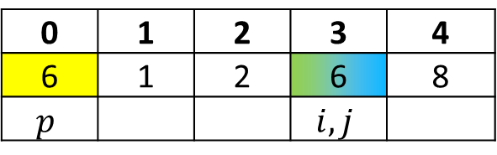
Sample 2
Quick Sort – 2nd pass (Left Subarray)
Start moving $i$ towards right and $j$ towards left until they cross each other.
0 | 1 | 2 | 3 | 4
6 | 8 | 6 | 2 | 1
$$p$$ | $$i$$ |  |  | $$j$$
0 | 1 | 2 | 3 | 4
6 | 1 | 2 | 6 | 8
$$p$$ |  | $$i$$ | $$j$$
0 | 1 | 2 | 3 | 4
2 | 1 | 6 | 6 | 8
 |  | $$p$$
0 | 1 | 2 | 3 | 4
6 | 1 | 6 | 2 | 8
$$p$$ | $$i$$ |  |  | $$j$$
0 | 1 | 2 | 3 | 4
6 | 1 | 2 | 6 | 8
$$p$$ |  |  | $$i,j$$
0 | 1 | 2 | 3 | 4
6 | 1 | 6 | 2 | 8
$$p$$ | $$→$$ | $$i$$ |  | $$j$$
0 | 1 | 2 | 3 | 4
6 | 1 | 2 | 6 | 8
$$p$$ |  | $$j$$ | $$i$$
0 | 1 | 2 | 3 | 4
6 | 1 | 6 | 2 | 8
$$p$$ |  | $$i$$ | $$j$$
0 | 1 | 2 | 3 | 4
2 | 1 | 6 | 6 | 8
 |  | $$p$$

Slide 13
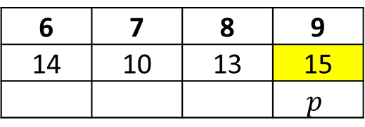
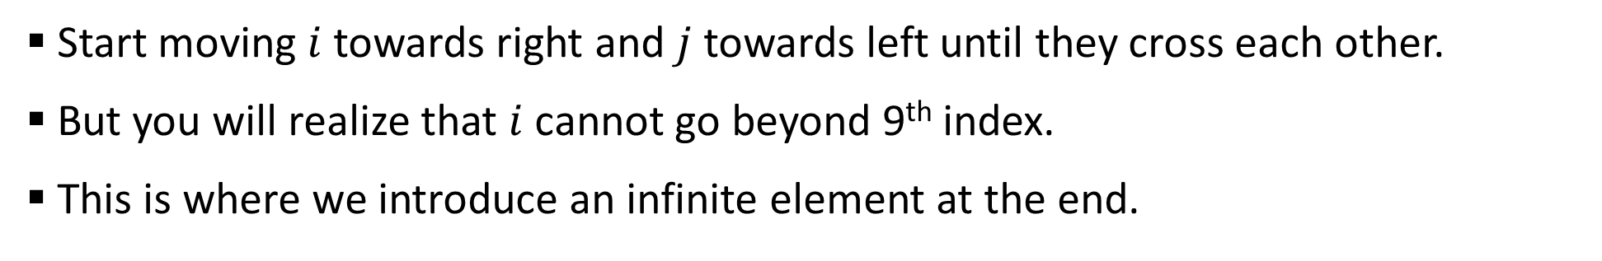
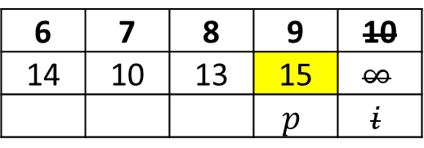
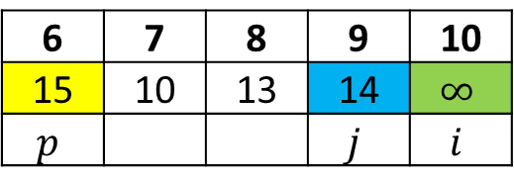
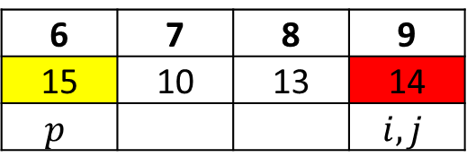

Sample 2
Quick Sort – 2nd pass (Right Subarray)
Start moving $i$ towards right and $j$ towards left until they cross each other.
But you will realize that $i$ cannot go beyond 9th index.
This is where we introduce an infinite element at the end.
6 | 7 | 8 | 9
15 | 10 | 13 | 14
$$p$$ | $$i$$ |  | $$j$$
6 | 7 | 8 | 9
15 | 10 | 13 | 14
$$p$$ |  |  | $$i,j$$
6 | 7 | 8 | 9 | 10
15 | 10 | 13 | 14 | $$∞$$
$$p$$ |  |  | $$j$$ | $$i$$
6 | 7 | 8 | 9 | 10
14 | 10 | 13 | 15 | $$∞$$
 |  |  | $$p$$ | $$i$$
6 | 7 | 8 | 9
14 | 10 | 13 | 15
 |  |  | $$p$$

Slide 14
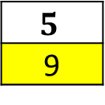
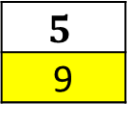
Sample 2
Quick Sort – 2nd pass (Right Subarray)
Let’s now revisit both the branches so far.
The elements 6, 9 and 15 are at their correct respective indices.
We have completed 2nd pass.
0 | 1 | 2 | 3 | 4
2 | 1 | 6 | 6 | 8
$$5$$
9
6 | 7 | 8 | 9
14 | 10 | 13 | 15
2
6
$$5$$
9
9
15
0 | 1
2 | 1
3 | 4
6 | 8
6 | 7 | 8
14 | 10 | 13

Slide 15
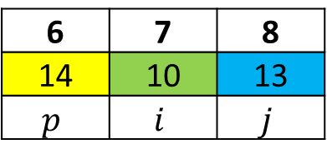
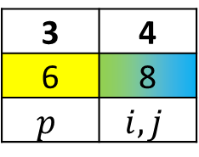
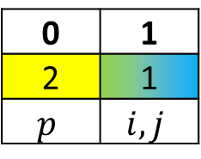
Sample 2
Quick Sort – 3rd pass
Before moving to 3rd pass, it is important to note that although you can repeat the same process on a subarray of 2 elements, you don’t need to.
However, a subarray of size 3 will be go through a complete run.
0 | 1
2 | 1
$$p$$ | $$i,j$$
3 | 4
6 | 8
$$p$$ | $$i,j$$
6 | 7 | 8
14 | 10 | 13
$$p$$ | $$i$$ | $$j$$

Slide 16
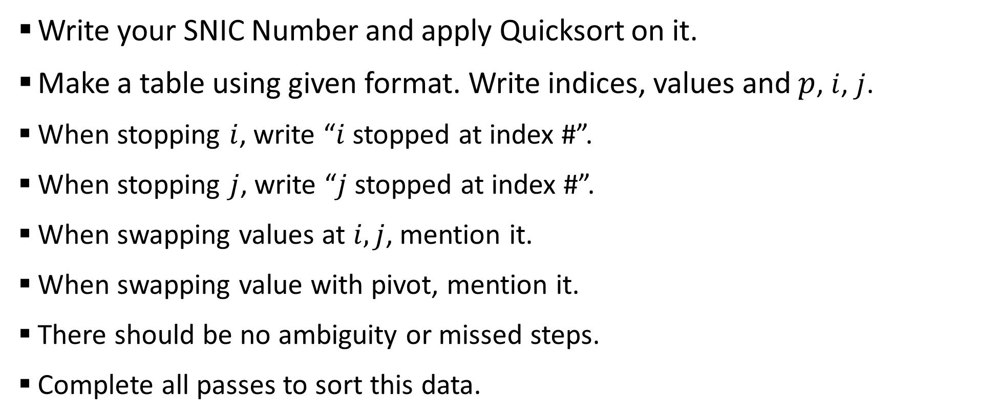
Sample 2
Exercise
Write your SNIC Number and apply Quicksort on it.
Make a table using given format. Write indices, values and $p$, $i$, $j$.
When stopping $i$, write “$i$ stopped at index #”.
When stopping $j$, write “$j$ stopped at index #”.
When swapping values at $i,j$, mention it.
When swapping value with pivot, mention it.
There should be no ambiguity or missed steps.
Complete all passes to sort this data.

Slide 17
Sample 2
Analysis of Selection Sort
DEMO

Slide 18



THANK YOU
Owais Hussain
+92 345-3174270
owais.hussain@kiet.edu.pk
https://www.researchgate.net/profile/Owais-Hussain-3

